Slide 1
Response of Olympia oysters
(Ostrea lurida) to changing environmental conditions
J. Emerson Heare

Slide 2
Olympia Oysters
Restoration
Research
Implications

Slide 3
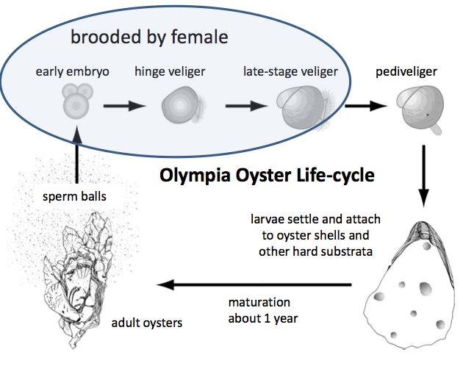
Olympia Oyster - Life History
Brooded larvae
Rhythmic hermaphrodites
~30 mm @ 1 yr

Slide 4
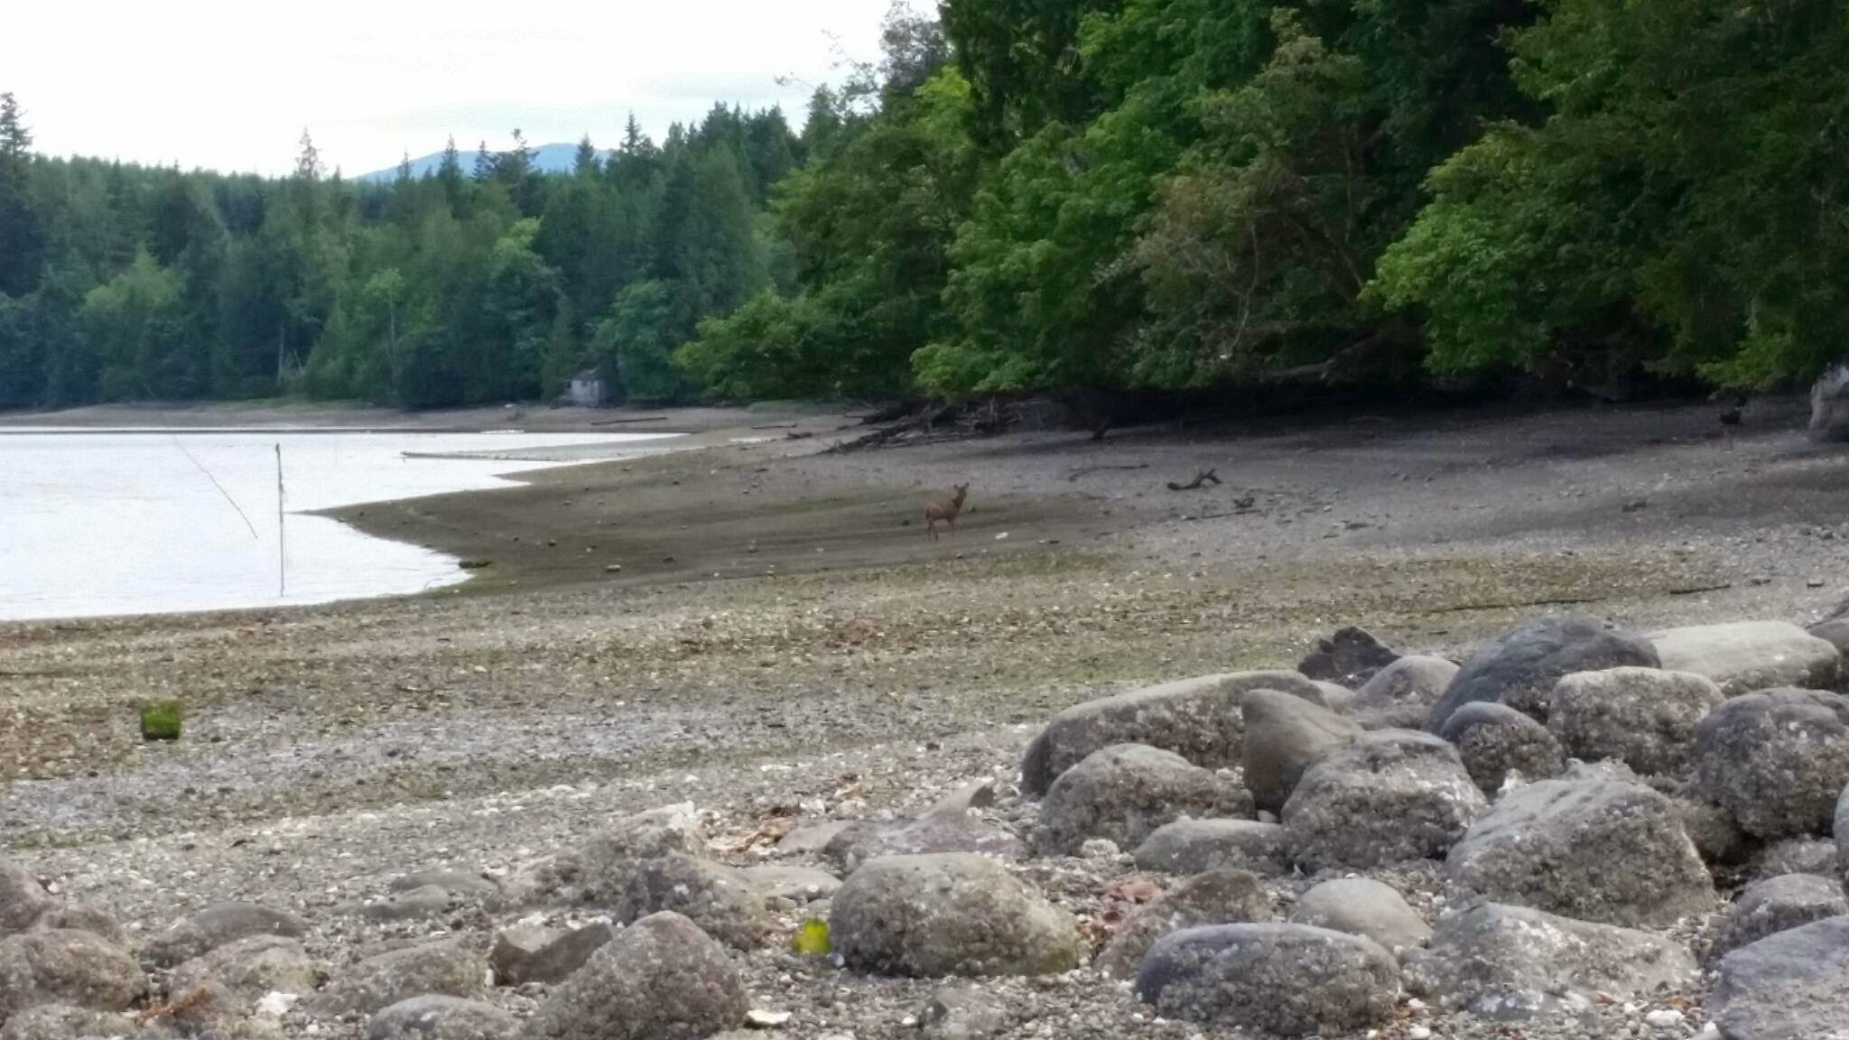
Olympia Oyster - Habitat
Hard substrate
Thermal range 5 - 25 C
Brackish to marine

Slide 5
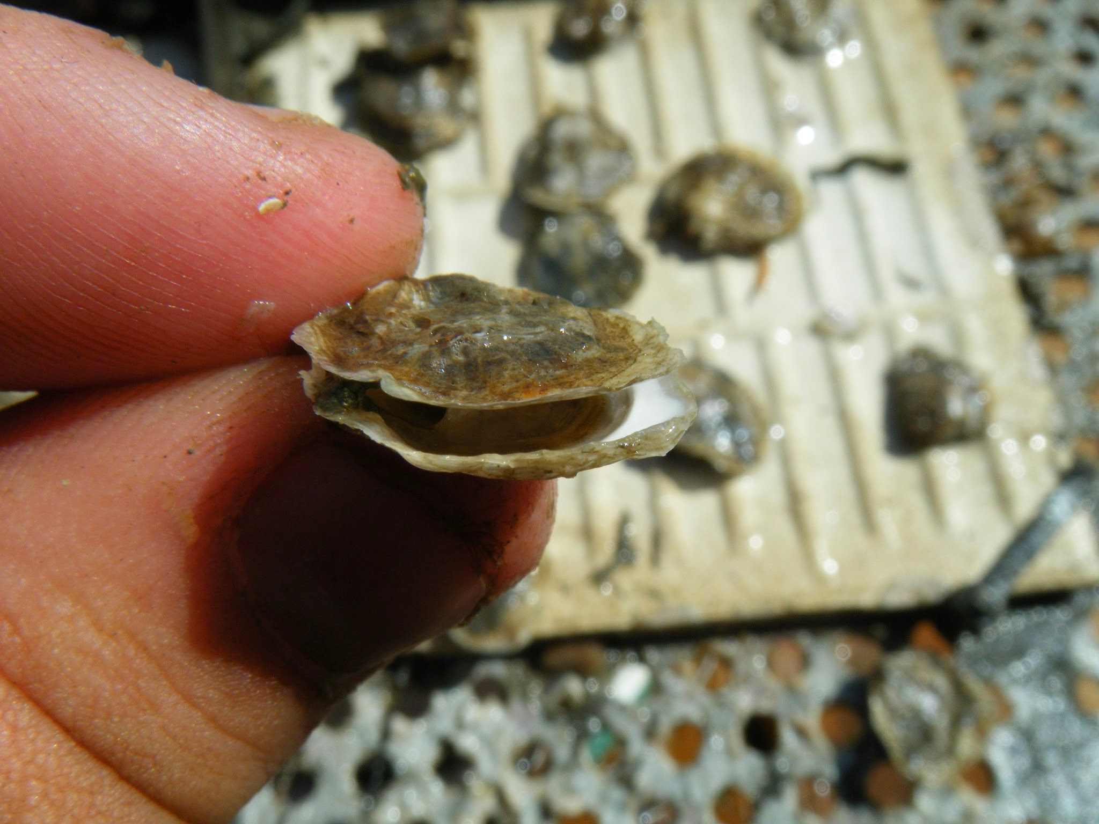
Olympia Oysters
West Coast native
$25 /lb
Decline due to:
Overharvesting
Habitat Loss
Invasive Species
Pollution

Slide 6
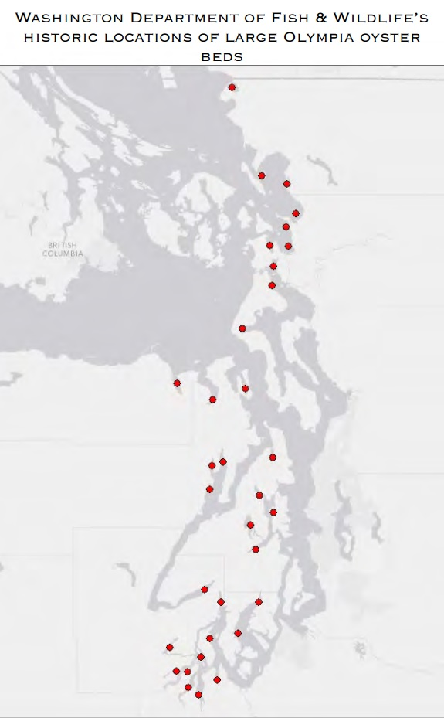
Olympia Oyster - Puget Sound
Historic: 13.4-26.7%
Current: <5%

Slide 7
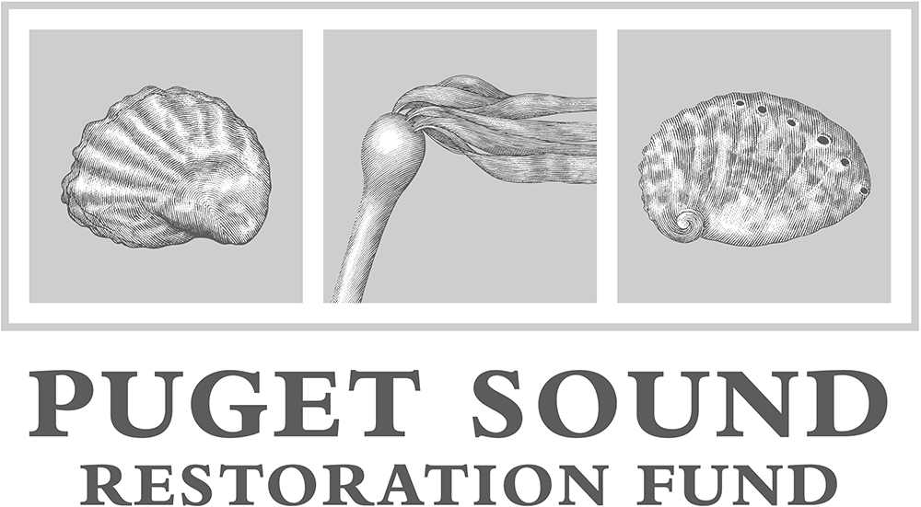
Olympia Oyster - Restoration
Washington Shellfish Initiative:
Restore 19 populations by 2022
Create hatchery breeding program
Puget Sound Restoration Fund:
Kenneth K Chew Center
2 of 19 sites
20 of 100 acres

Slide 8
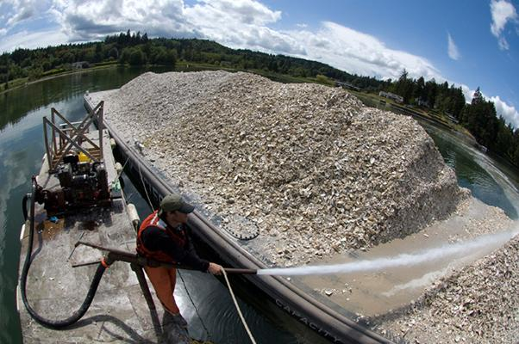
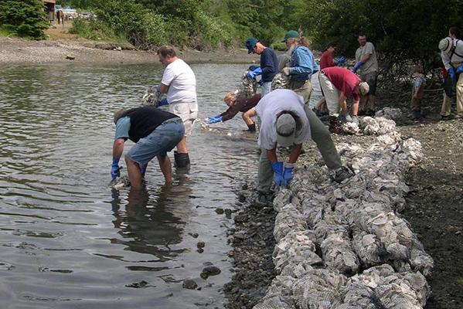
Restoration - Methods
Habitat restoration:
Shell
Habitat modification
Supplementation:
Transplantation
Seed outplant

Slide 9
How diverse are Puget Sound Olympia oyster populations?

Slide 10
Fractured Population Theory
Populations fractured
populations less connected
Notes:
Blake Theory, Somewhat similar to findings from David Sticke

Slide 11
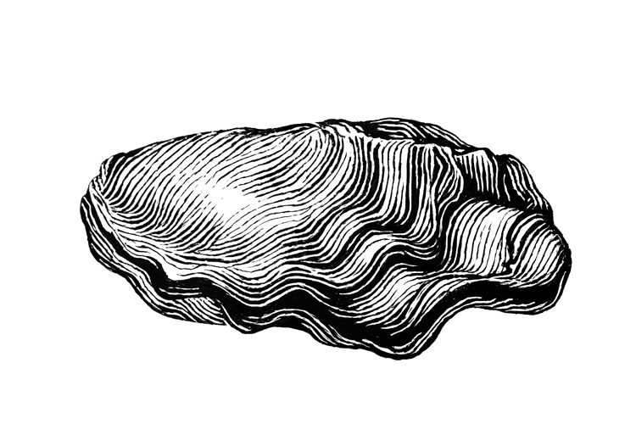
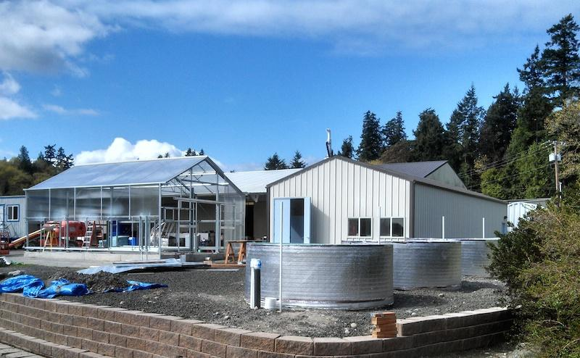
Wild Stock Collected
(Fall 2012)
Bred in Hatchery
(Spring 2013)
Seed Outplanted
(Summer 2013)
Monitored 1 Year
(Fall 2014)

Slide 12
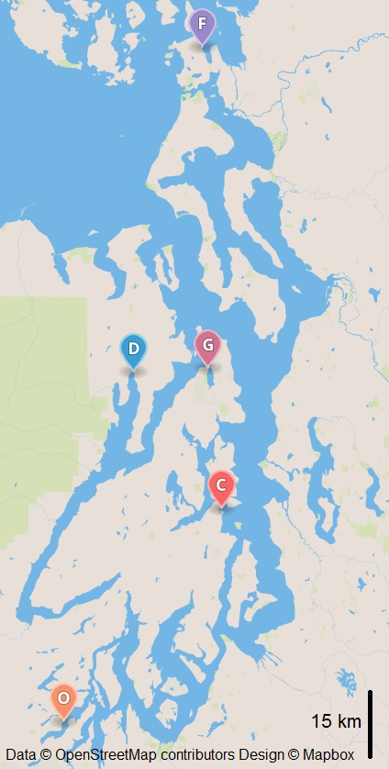
Reciprocal Transplant
Wild oysters collected
(Fall 2012)
Broodstock spawned
(Spring 2013)
Seed oysters outplanted (Summer 2013)

Slide 13
Seed Outplanted
(Summer 2013)
Monitored 1 Year
(Fall 2014)
Mortality
Growth
Reproduction
Notes:
Unique reproduction method

Slide 14
Northern Site:
Fidalgo Bay
Strait of Juan de Fuca
Under restoration
Hood Canal:
Dabob Bay
Tarboo Creek
Shallow lagoon
Central Site:
Clam Bay
Bainbridge channel
Deep cold water
Southern Site:
Oyster Bay
Warmer waters
High nutrient load

Slide 15
Reciprocal Transplant - Results: Mortality
Northern Site

Slide 16
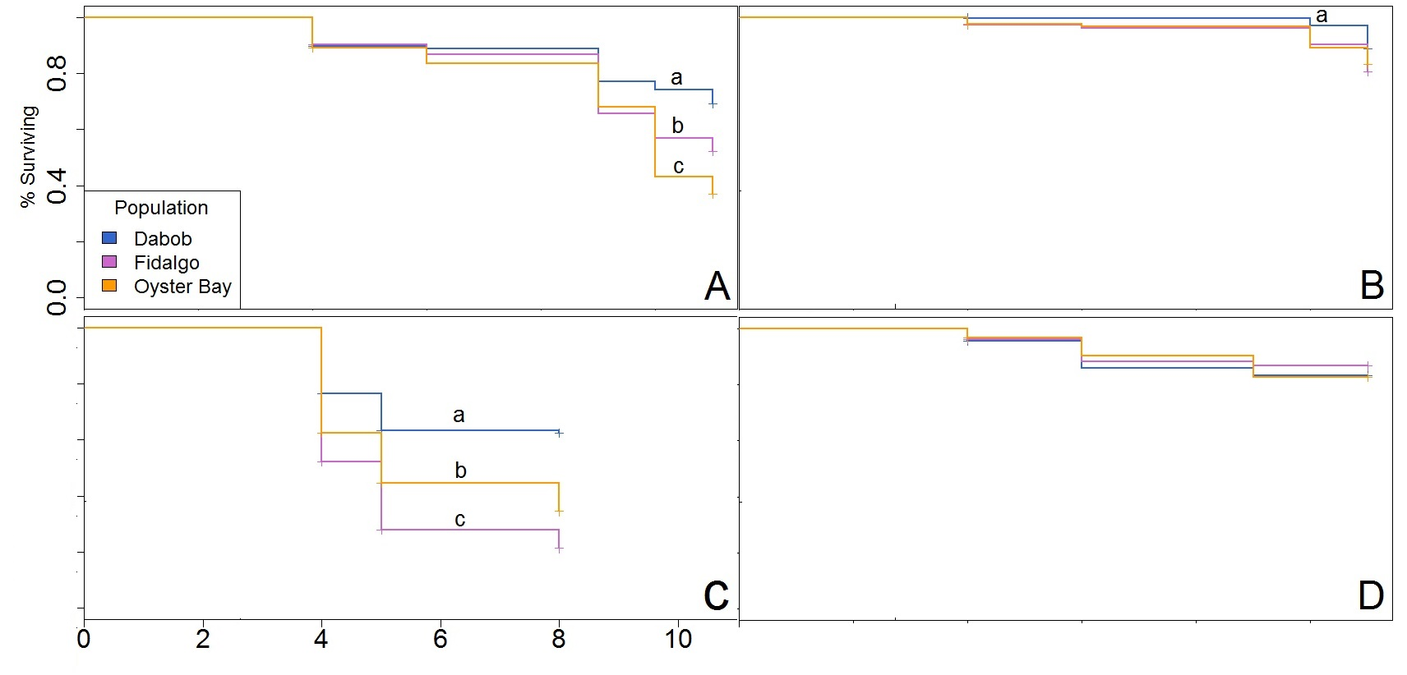
Reciprocal Transplant - Results: Mortality
Southern Site
Central Site
Hood Canal
Northern Site
Survival Time from Outplant in Months

Slide 17
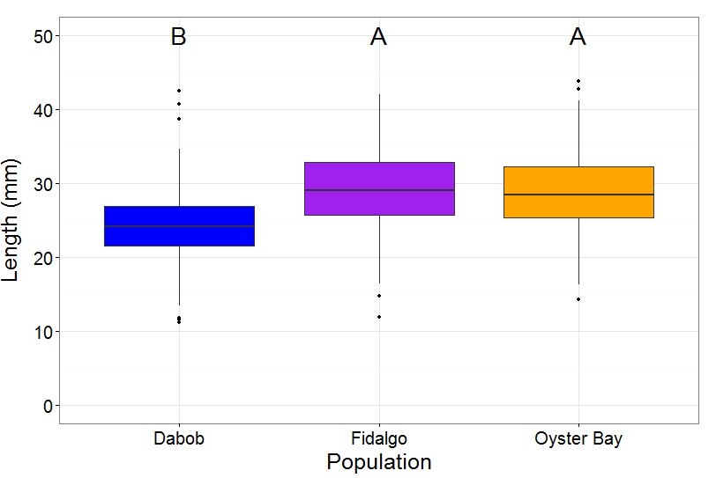
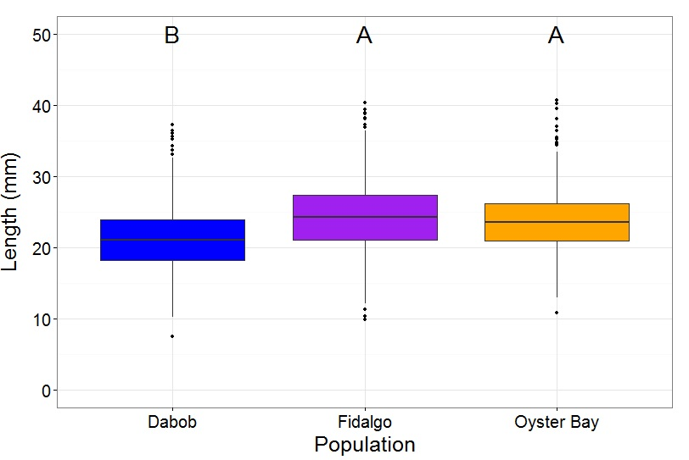
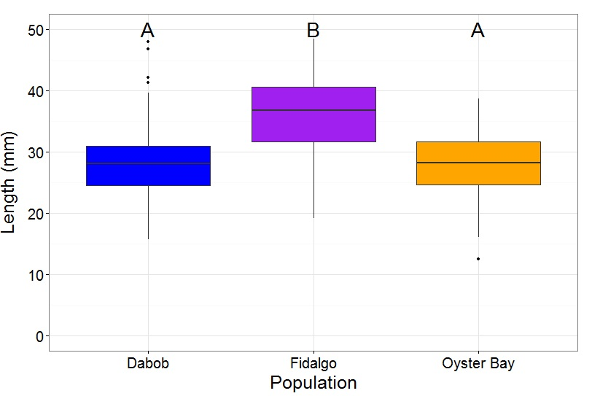
Reciprocal Transplant - Results: Growth
Northern Site Central Site Southern Site

Slide 18
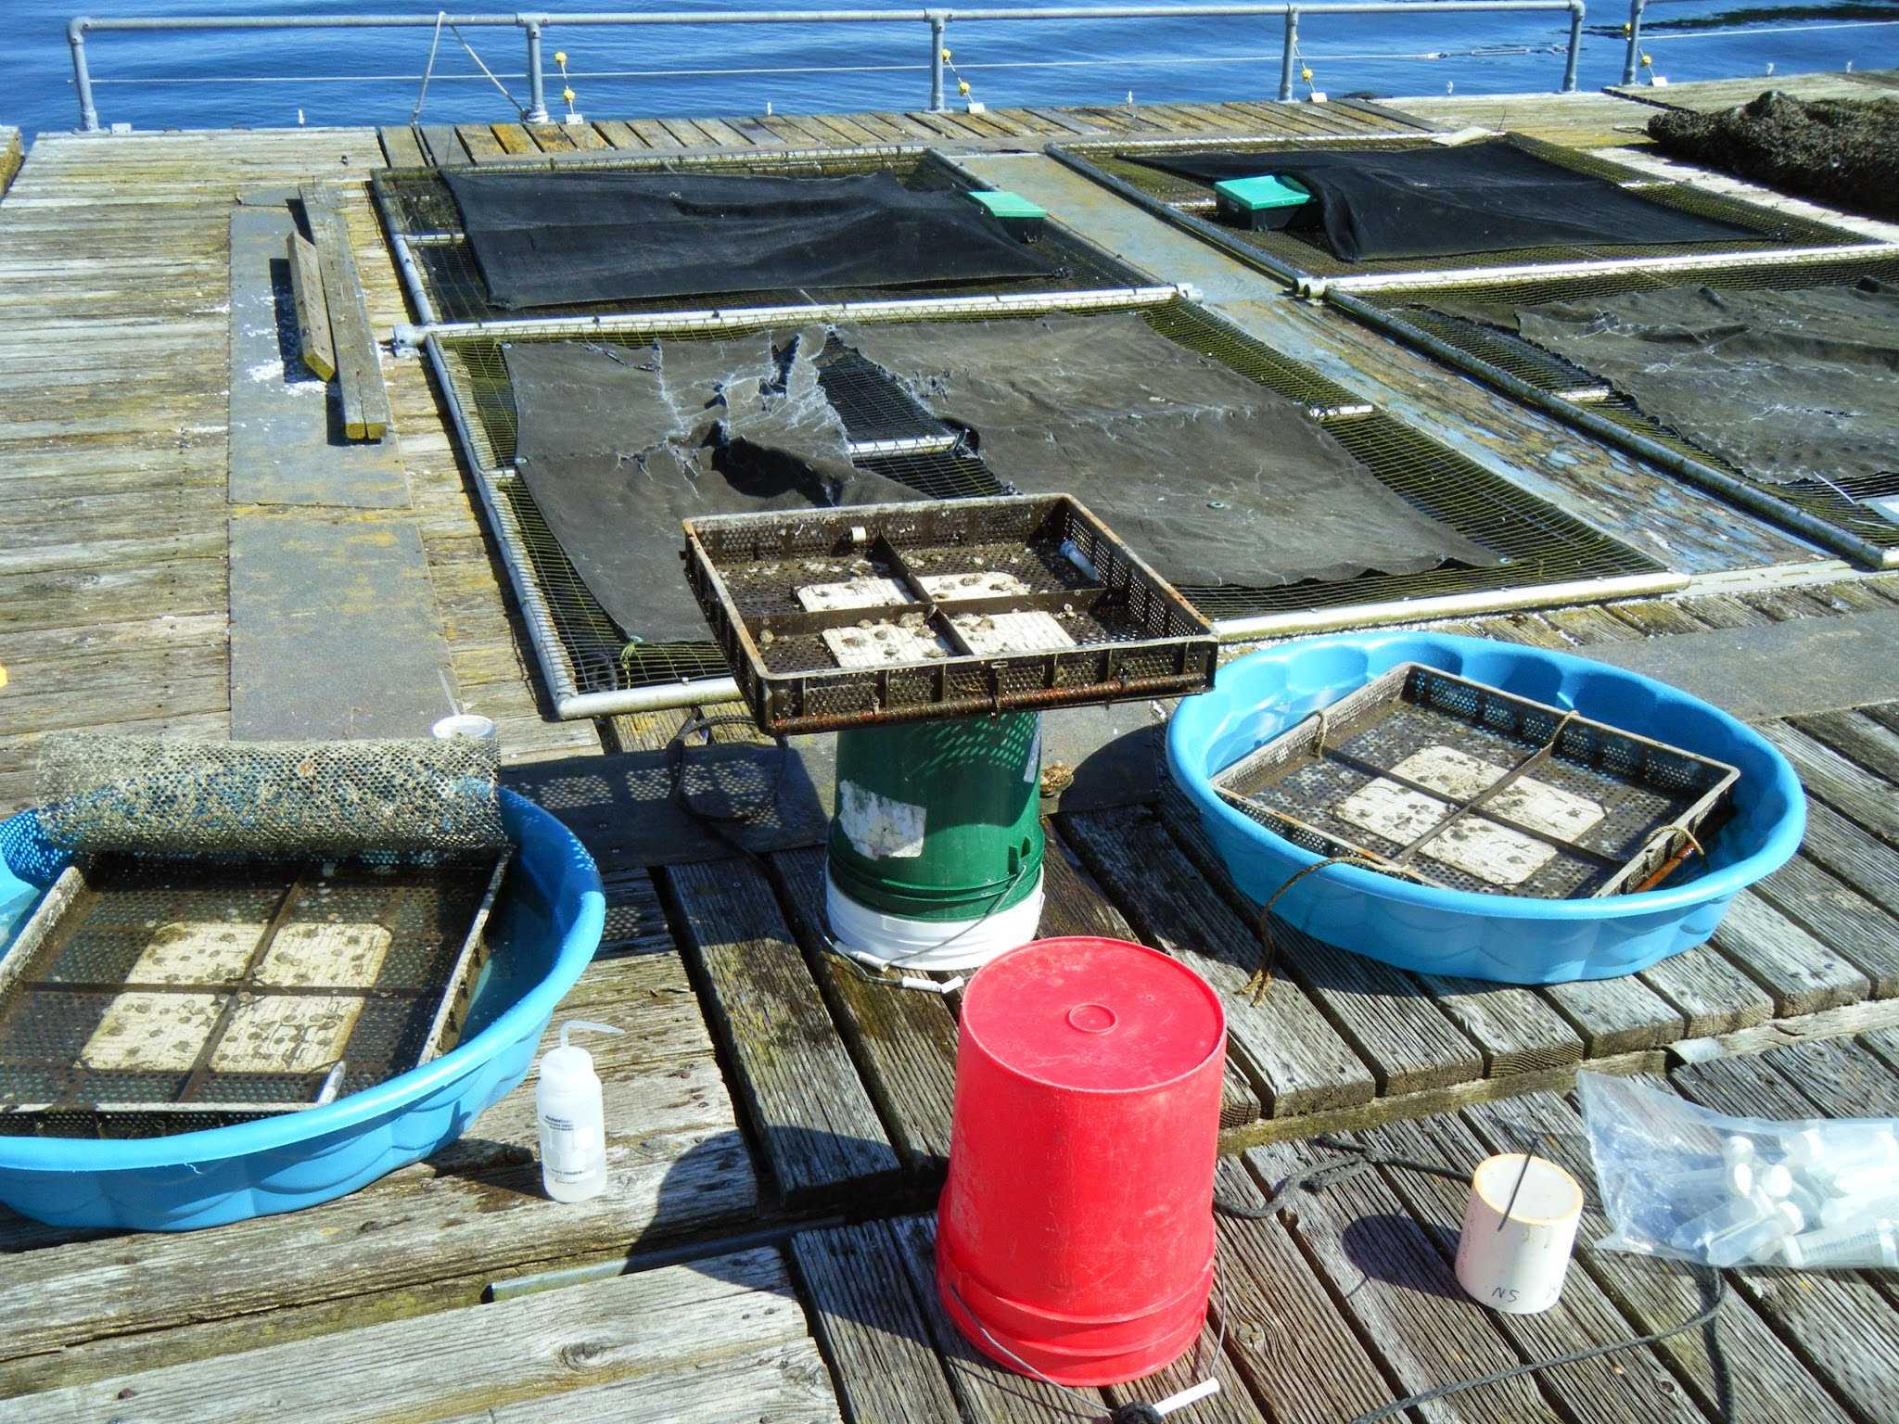
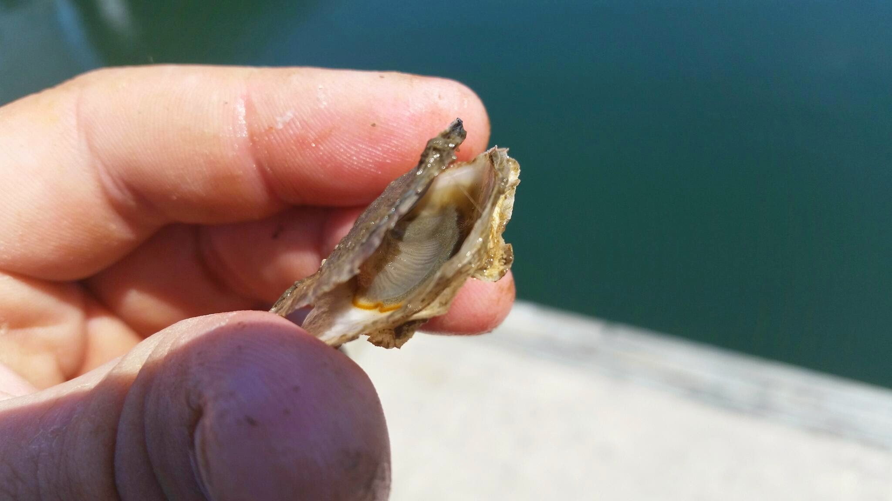
Non-Lethal Larval Brood Sampling
Dessicate
Expose
Inspect

Slide 19
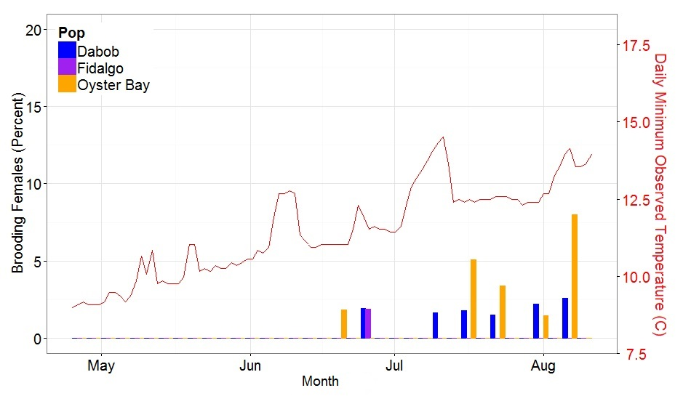
Reciprocal Transplant - Results: Reproduction
Central Site

Slide 20
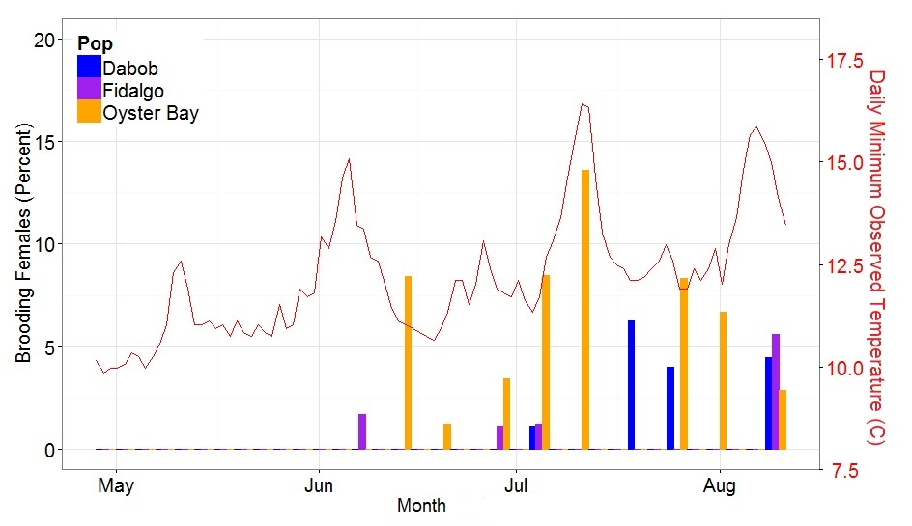
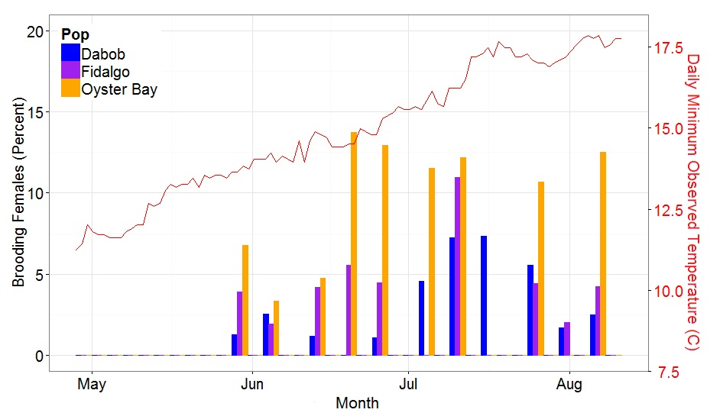
Reciprocal Transplant - Results: Reproduction
Northern Site Central Site Southern Site

Slide 21
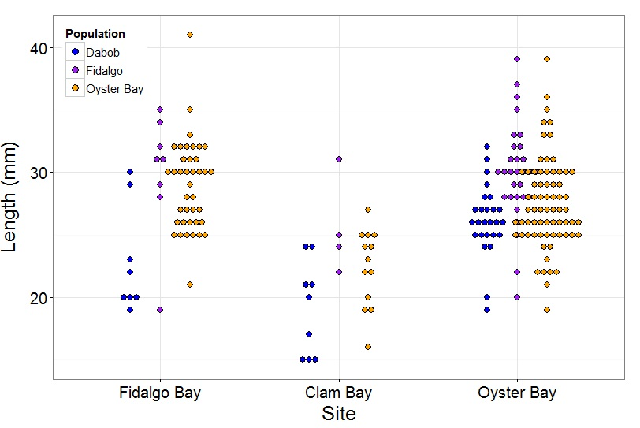
Reciprocal Transplant - Results: Size at Brooding
Northern Site Central Site Southern Site

Slide 22
Reciprocal Transplant - Results:Degree Day
Degree Day = (n=Peak, i=Winter)∑ Temp^{min}-8C
 | Northern Site | Southern Site
Fidalgo Bay | 513 | 453
Dabob Bay | 513 | 453
Oyster Bay | 354 | 308

Slide 23
How diverse are Puget Sound Olympia oyster populations?
VERY!

Slide 24
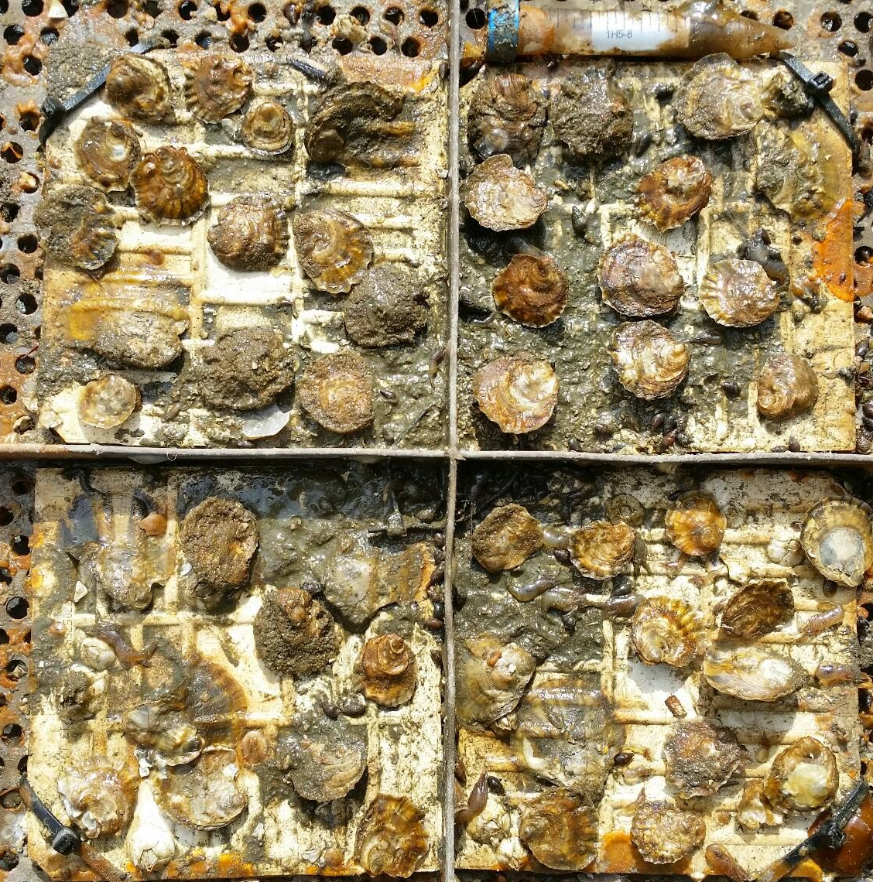
Diversity
Dabob Bay:
Highest Survival
Smallest Size
Smallest Brooding Female
Dabob Bay:
Adaptation to extreme conditions
Energy Budget Tradeoffs

Slide 25
Diversity
Oyster Bay:
Highest Proportion of Brooding Earliest Peak Brooding
Oyster Bay:
Increased Competition
Consistently Warm Water

Slide 26
What does this mean for restoration?

Slide 27
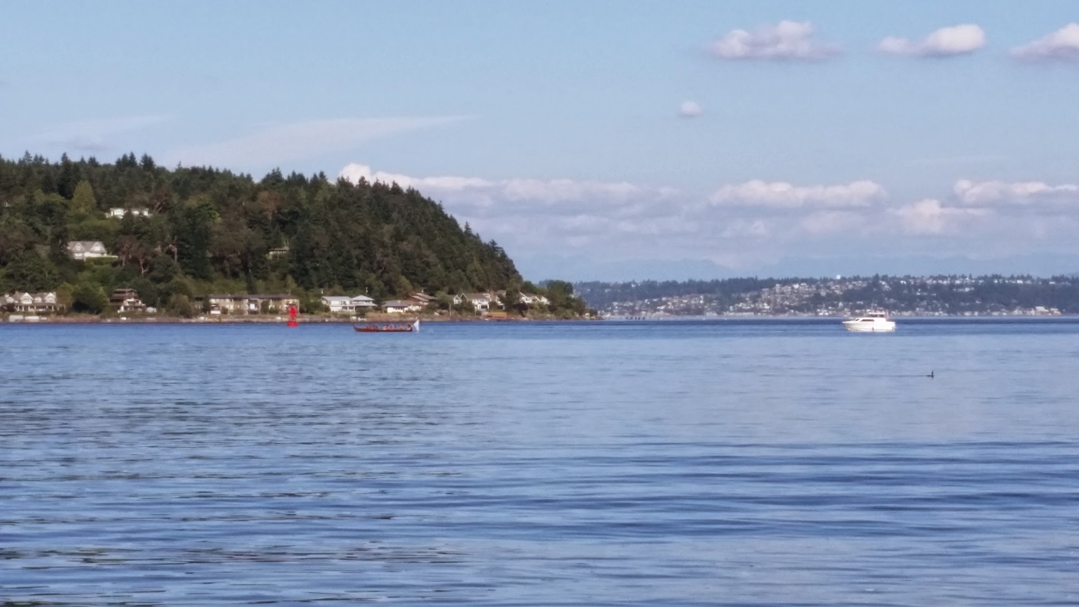
Restoration Suggestion - Survival
Hardy Broodstock
Pro:
Survive Best
Resistant
Con:
Susceptible
Unlikely to reproduce

Slide 28
Restoration Suggestion - Reproductive
Abundant Reproduction
Pros:
Numerous Offspring
Colonizers
Cons:
Lack of Stress Resilience
Outcompete

Slide 29
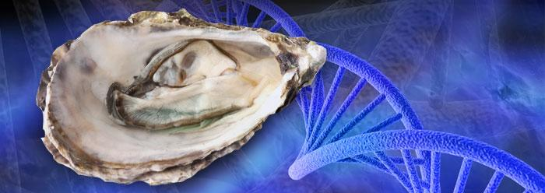
Restoration Suggestion - Genetic Diversity
Local Broodstock
Pros:
Maintain Diversity
Avoid Low Fitness Hybrid
Ensure Stable Stock Structure
Cons:
Unintentional Domestication
Mal Adapted Population
Lack of Local Definition

Slide 30
Outstanding Questions

Slide 31
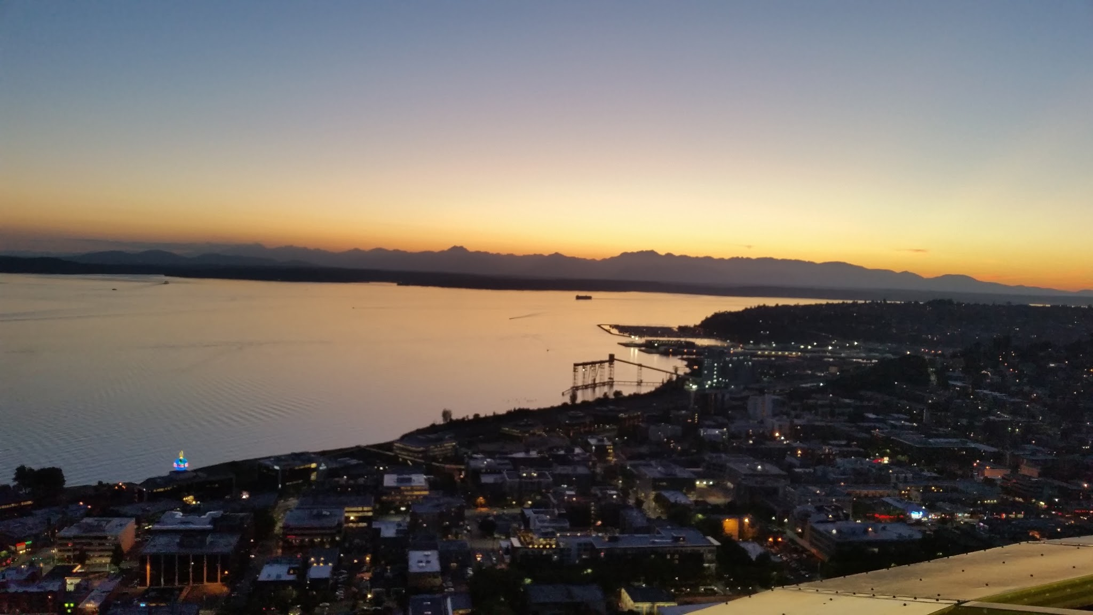
Summary!
Distinct phenotypes exist!
Lowest risk option, local broodstock

Slide 32
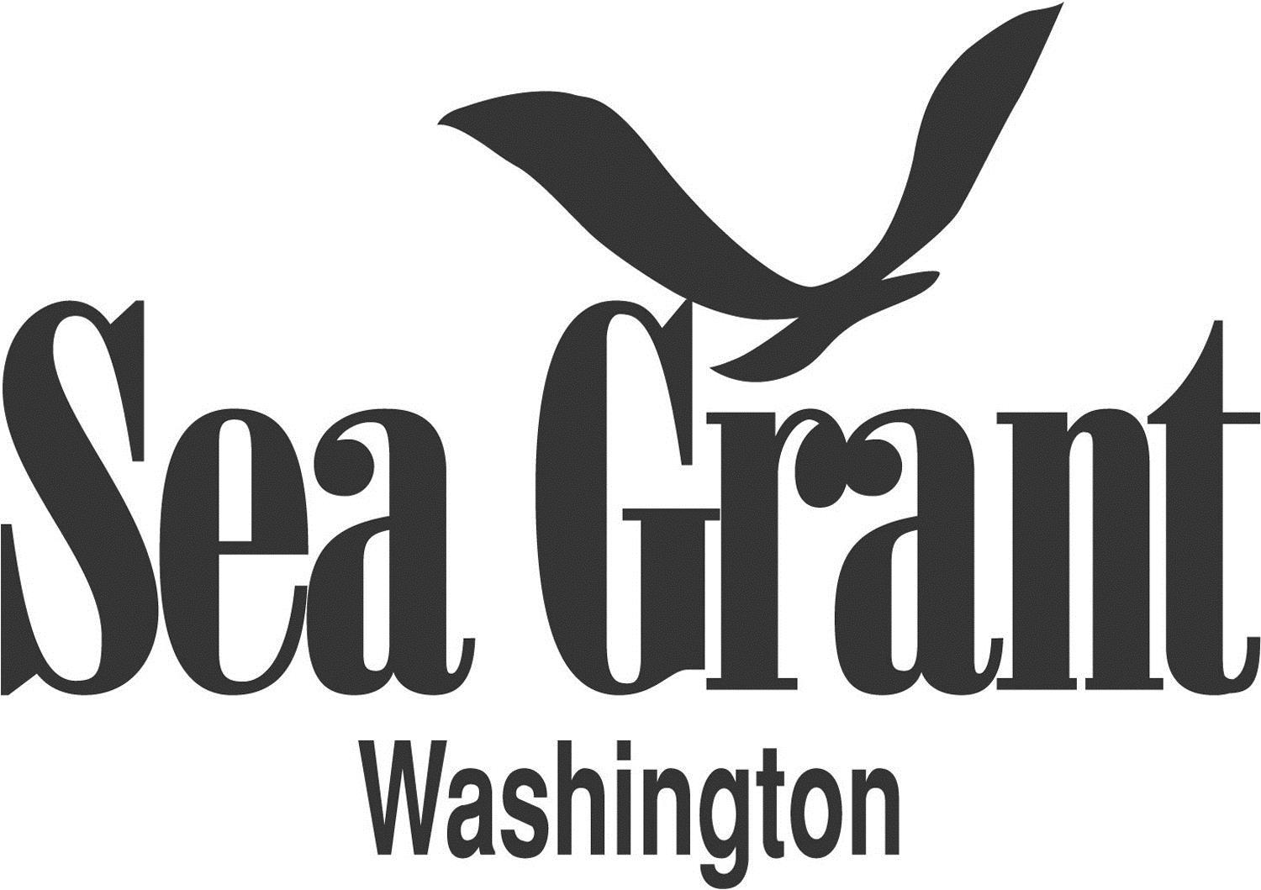
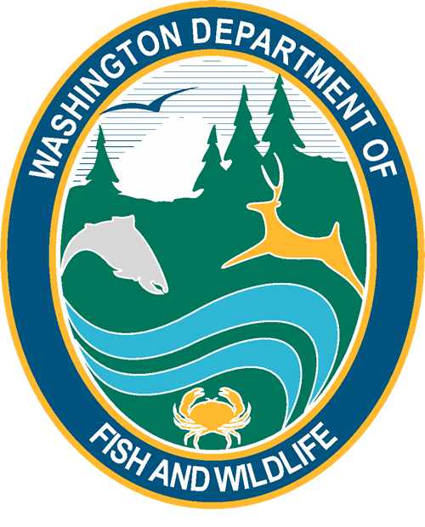
Acknowledgements

Slide 33
Acknowledgements
PSRF:
Ryan Crim
Brian Allen
Betsy Peabody
Stuart Ryan
WDFW:
Brady Blake
Crab Fresh:
Brendan Mahaffey
Jeff Koenings
Rick Tweed
Hatchery Crew
Fidalgo Marina:
Einar Sortun
Yacht Owners
Taylor Shellfish:
Molly Jackson
Sara Wykoff
Ed Jones
NOAA:
Rick Goetz
Dive Team
Netpen Crew
Fagergren Family
Rockpoint Oyster Company:
Dick Steele
Crew

Slide 34
Acknowledgements

Slide 35
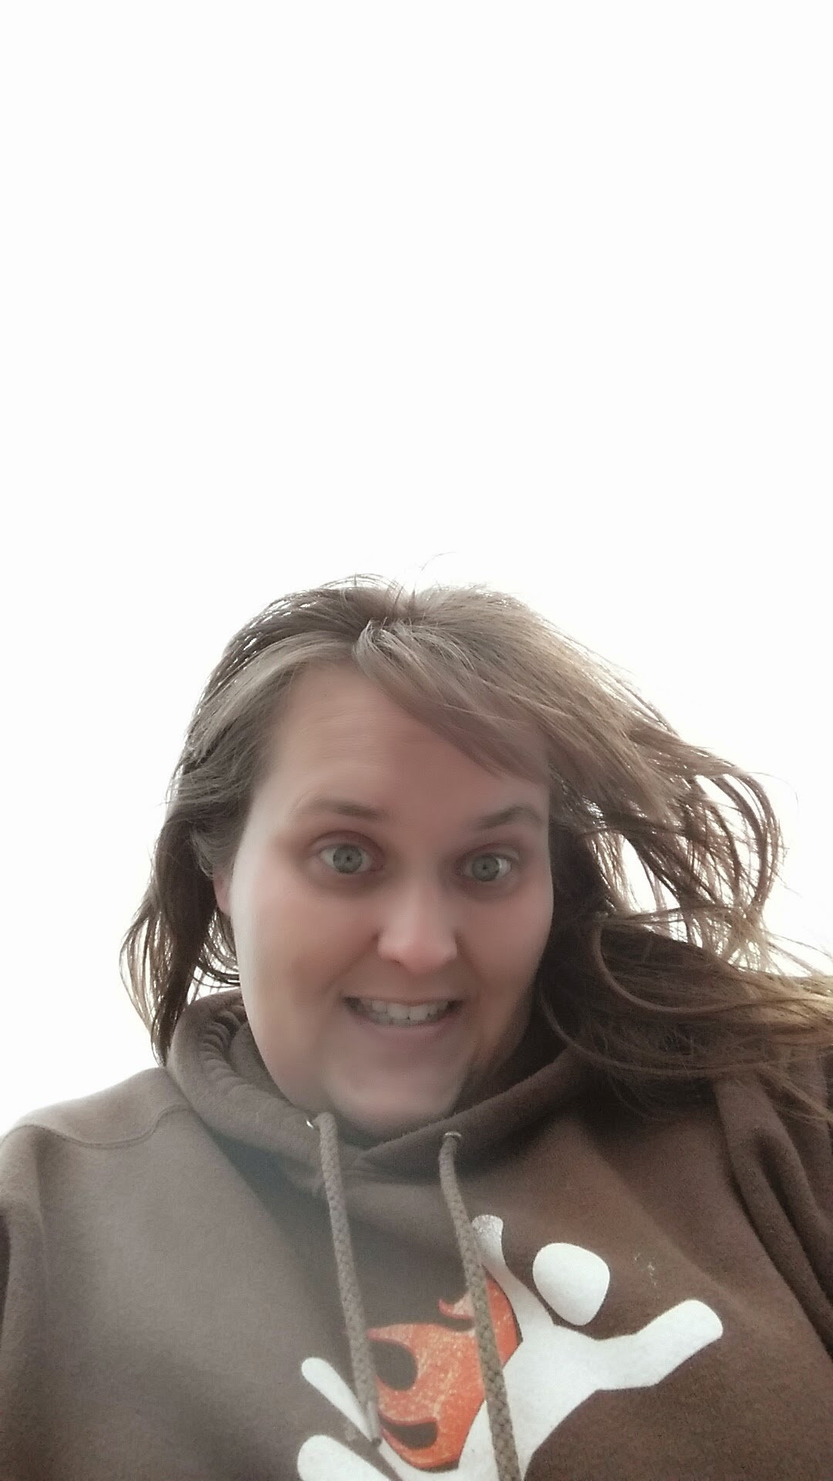
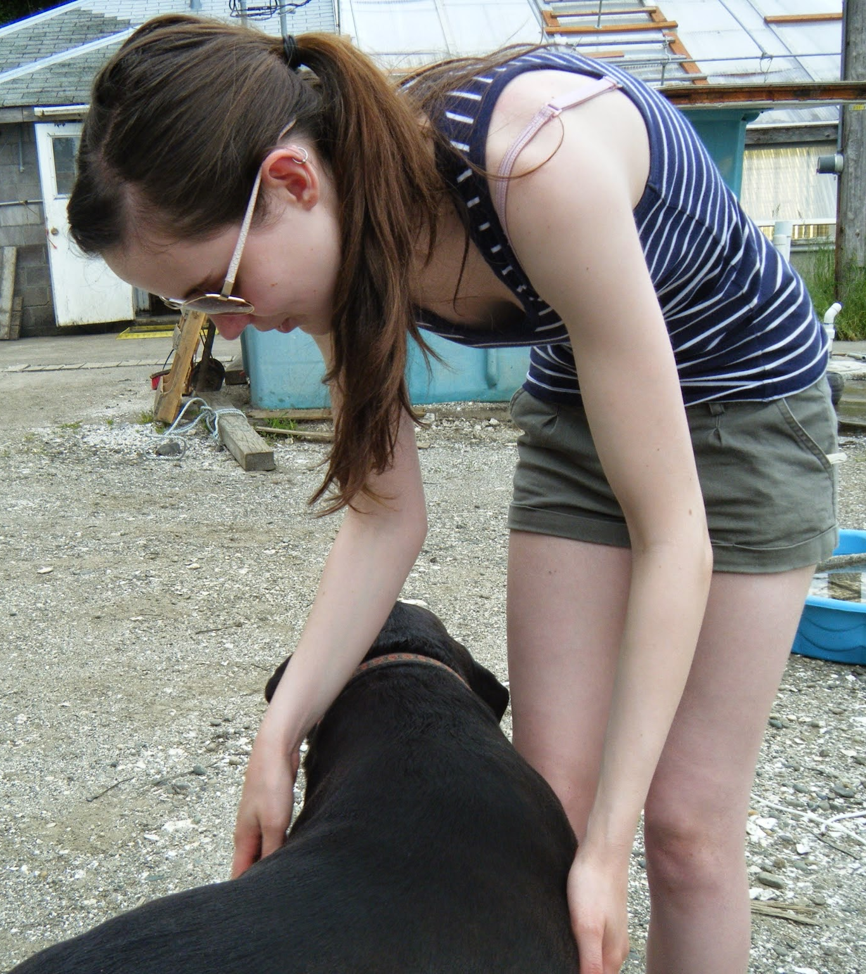
Thanks
Roberts Lab:
Sam White
Claire Olson
Mackenzie Gavery
Emma Timmins-Schiffman
Grace Crandall
Jonathon Allen
Etilet Maipi
Samantha Adams
Hannah Wear
Jessica Richards
Katie Jackson
Andy Jasonowicz
Doug Immerman
Megan Hintz
Jay Dimond
Giles Goetz

Slide 36
Thanks
Continued:
L. Christine Savolainen
Sean Bennet
Joelle Blais
Joe Stevick
Bethany Stevick
Lisa Crosson
Alicia Godersky
Lea I. Savolainen
Photo Credits:
Jake Heare
L. Christine Savolainen
Steven Roberts
Sam Adams
PSRF
NOAA Fisheries

Slide 37
Citations

Slide 38
Citations

Slide 41
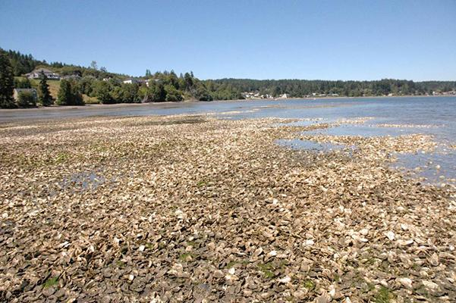
Restoration - Success?
Success Defined:
Long Term Persistence of Populations
Survival of Outplants
Effective Reproduction Efforts
Maintain Genetic Diversity

Slide 42
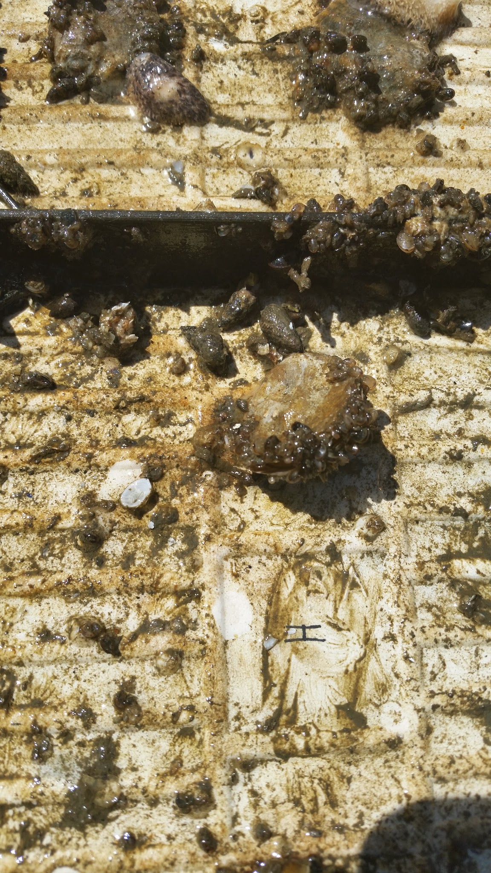
Restoration - Survival Success
Short Term Survival:
Cope with immediate habitat stressors
Withstand Seasonal Variations
Long Term Survival:
Survive multiple spawning seasons

Slide 43
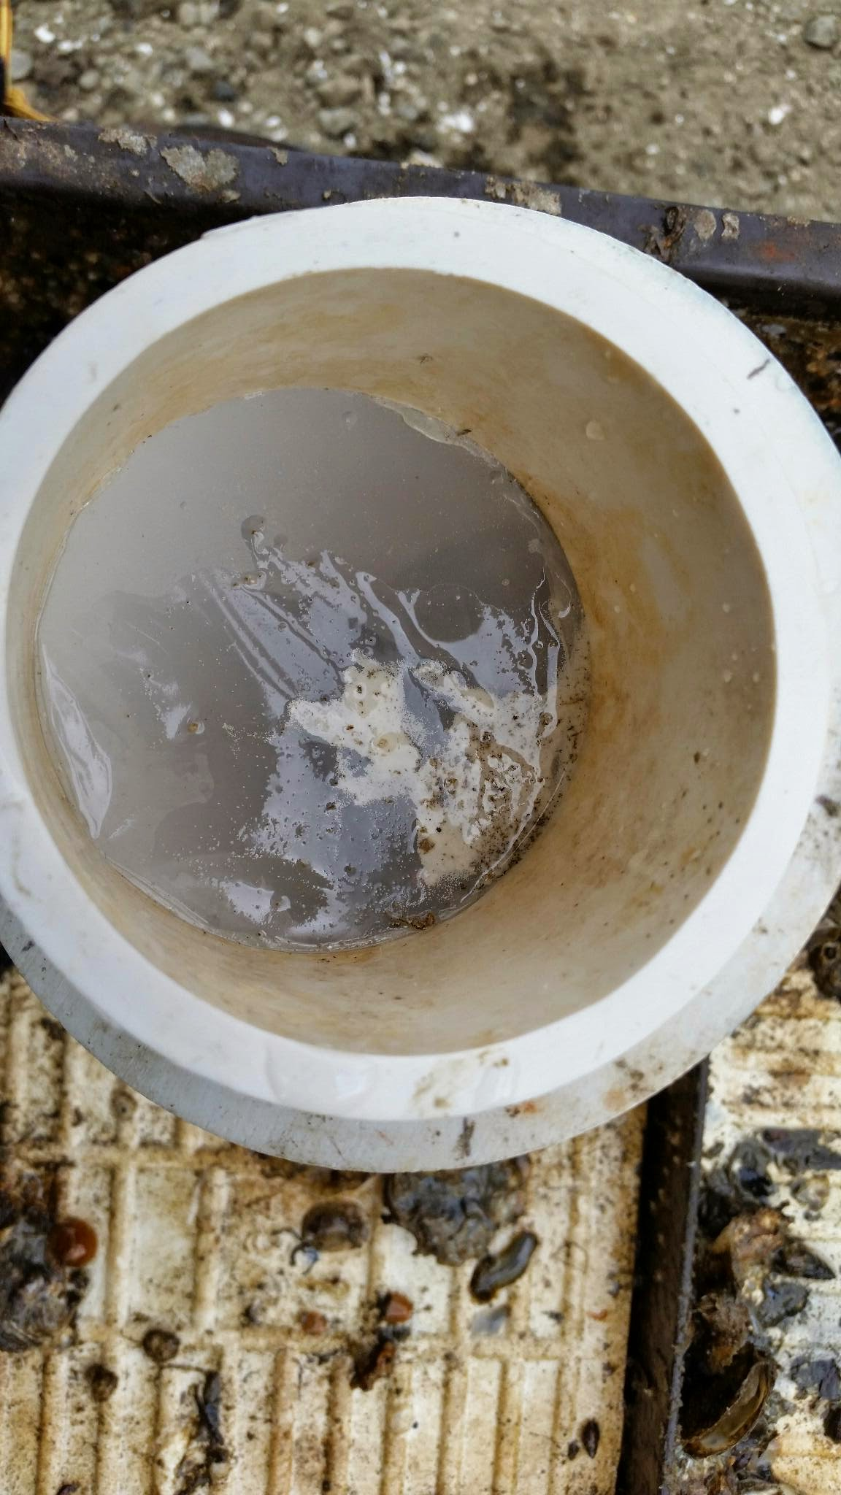
Restoration - Reproductive Success
Short Term:
Produce Viable Larvae
Long Term:
Larvae successfully recruit back to population
Multiple Seasons of Successful Recruitment
Eventual Self Sustaining Population

Slide 44
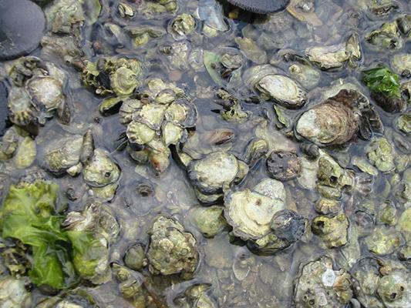
Restoration - Genetic Diversity Success
Short Term:
Maintain population genotypes
Long Term:
Support future adaptation through ensuring diversity of genotypes

Slide 45
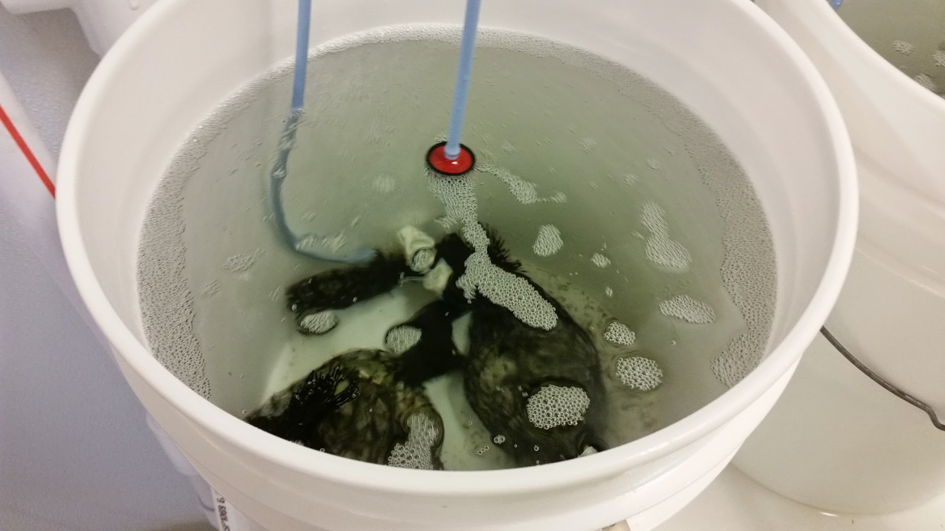
Population Supplementation - Definition
Using wild collected broodstock to produce offspring which will be outplanted into areas of interest.

Slide 46
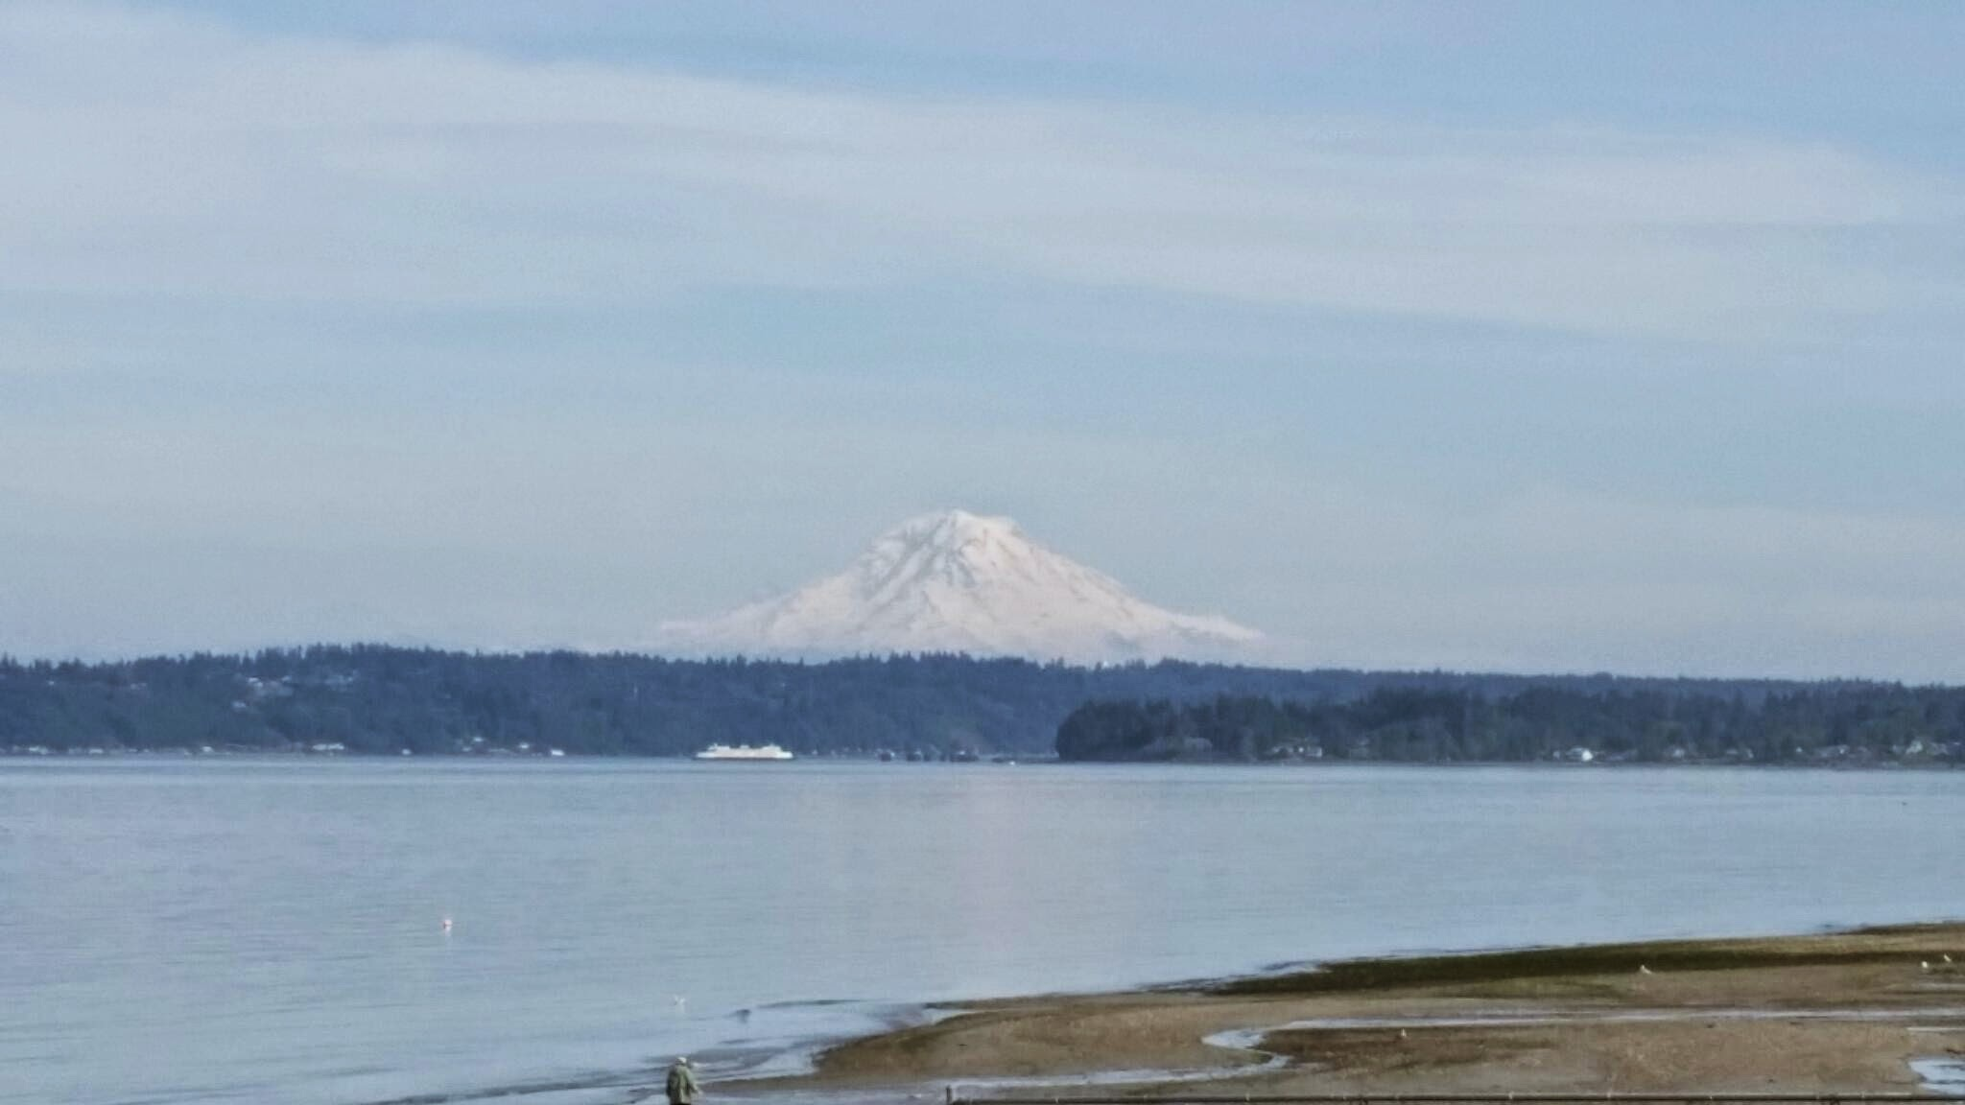
Population Supplementation - Positives
Actively Select Broodstock
Increase Viable Seed
Reduce Larval Losses
Introduce Beneficial Phenotypes
Enhance Competitive Ability
Colonize Extirpated Sites
Improve Success of Alternate Methods

Slide 47
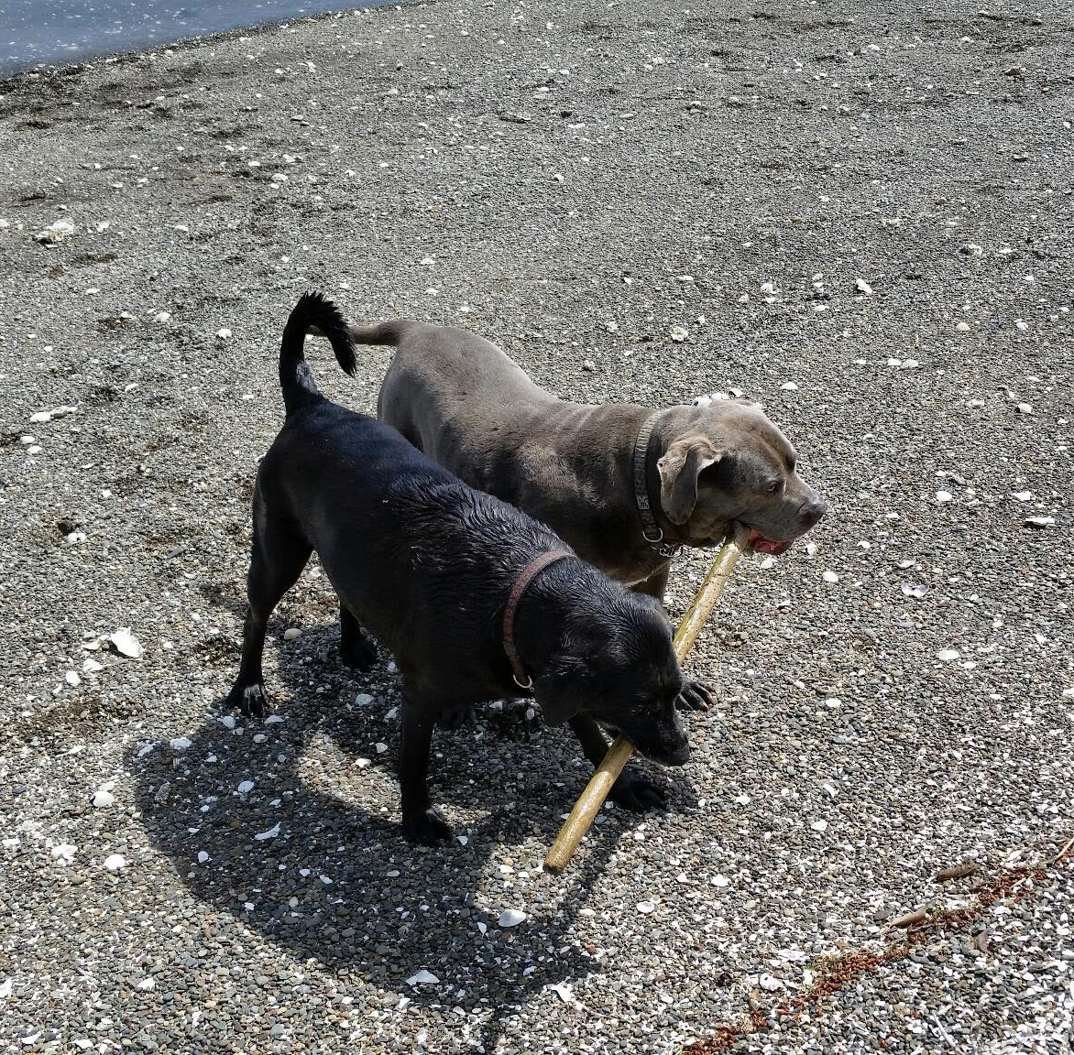
Population Supplementation - Negatives
Seed Failure
Conspecific Competition
Reduced Fitness Hybrid
Domestication
Reduce Genetic Diversity

Slide 48
Restoration Suggestion - Survival Success
Option 2
Site:
Suitable habitat with infrequent but extreme temperature variation
Supplement:
Highly Plastic Broodstock (Oyster Bay)
Pro:
High Survival
Quickly Copes with Stressor
Con:
Susceptible to long term chronic stressors
May require higher amounts of nutrients

Slide 49
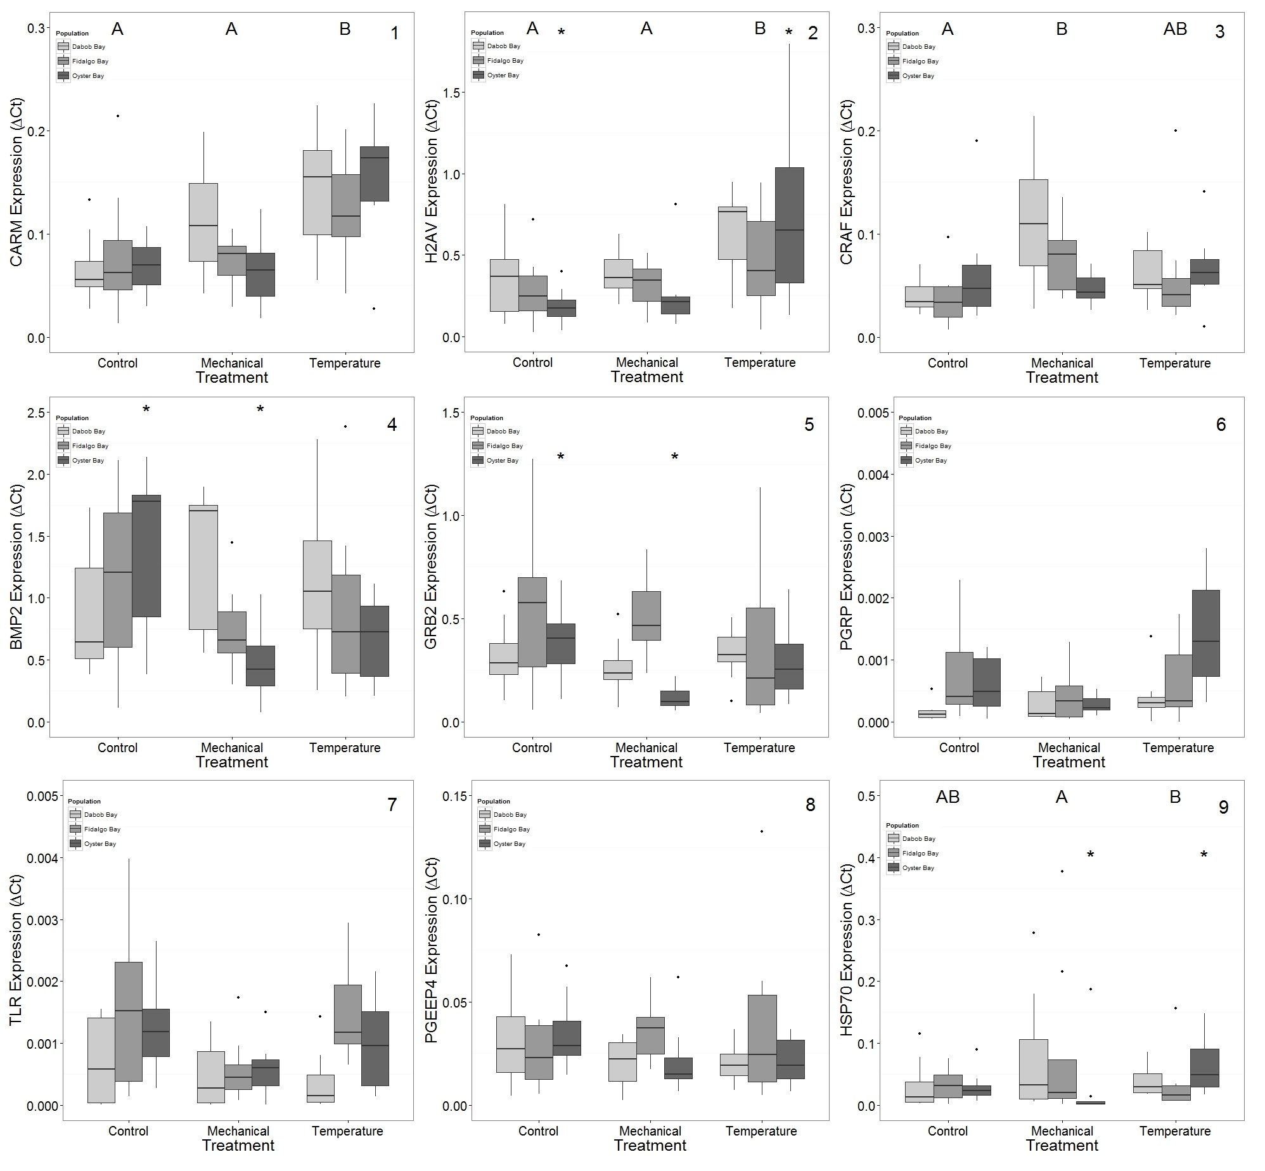
Population Phenotypes - Oyster Bay: mRNA
Gene Expression Observations:
Reduced Bone Morphogenic Protein 2
Reduced Growth-receptor bound protein 2
Increased Histone 2A.v variant
Findings Suggest:
Fast Response to Stress
High Phenotypic Plasticity

Slide 50
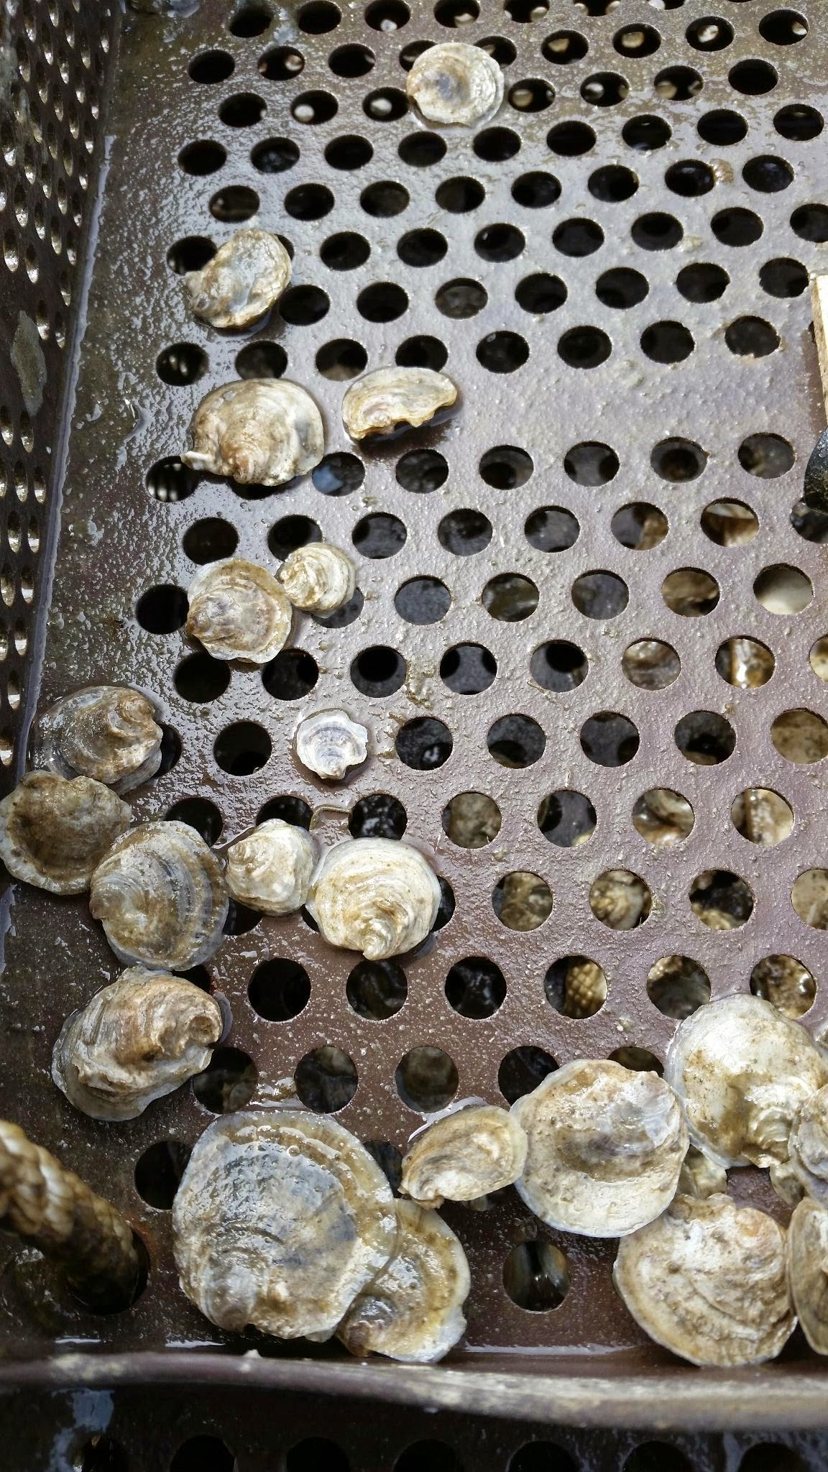
Population Phenotypes - Dabob Bay
Observed Traits:
Highest Survival
Smallest Size
Smallest Brooding Female
Possible Causes:
Adaptation to extreme conditions
Energy Budget Tradeoffs
Favor Survival over Growth/Reproduction

Slide 51
Population Phenotypes - Fidalgo Bay
Observed Traits:
Largest Growth in Southern Bays
Possible Causes:
Adapted to Cooler Habitat
Improved Feeding and Energy Efficiency

Slide 52
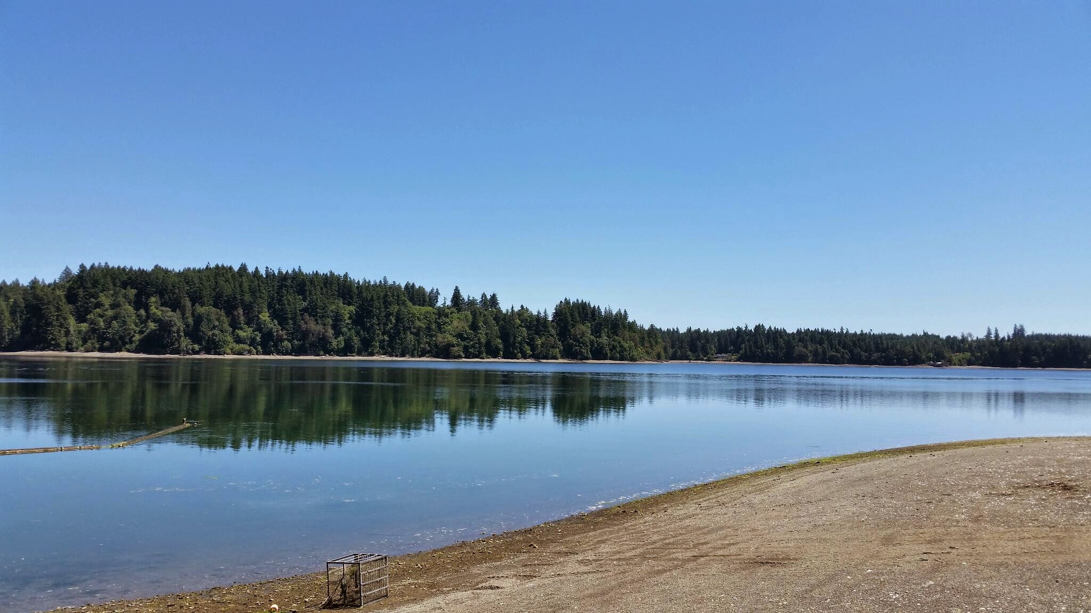
Population Phenotypes - Oyster Bay
Observed Traits:
Highest Amount of Broods Produced
Earliest Season Broods
Fast Response to Stress
Possible Causes:
Increased Competition
Consistently Warm Water
High Phenotypic Plasticity

Slide 53
Stock Structure - Definition

Slide 54
Population Phenotypes - Oyster Bay
Observed Traits:
Highest Amount of Broods Produced
Earliest Season Broods
Stress resilience project elucidated underlying expression profile differences.

Slide 55
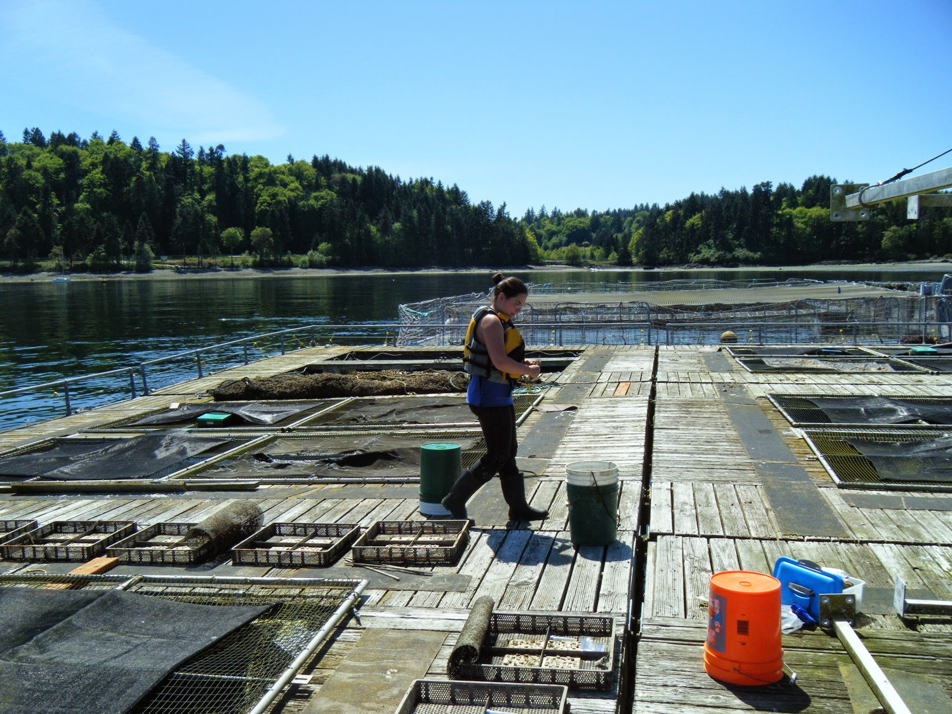
Reciprocal Transplant - Monitoring
4 Sites
1 Year
Temperature Loggers
Visited at Regular Intervals
Spawning Season visited weekly
Data Collected
Mortality
Size
Number of Brooding Females
Size of Brooding Females
Sampling
Pre Outplant
Post Mortality Event
1 Year Post Outplant

Slide 56
Stock Structure - Survival

Slide 57
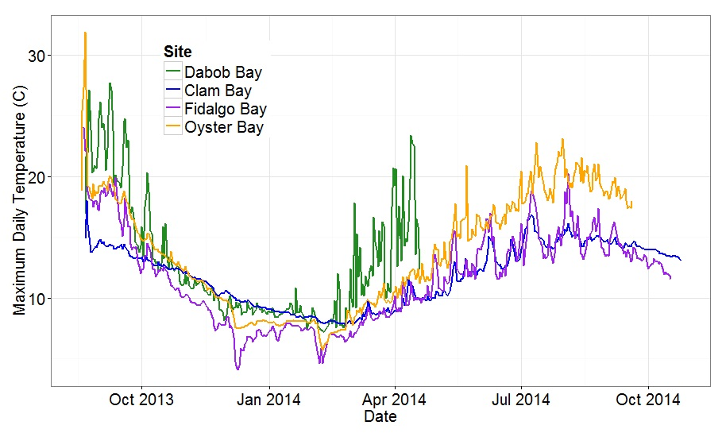
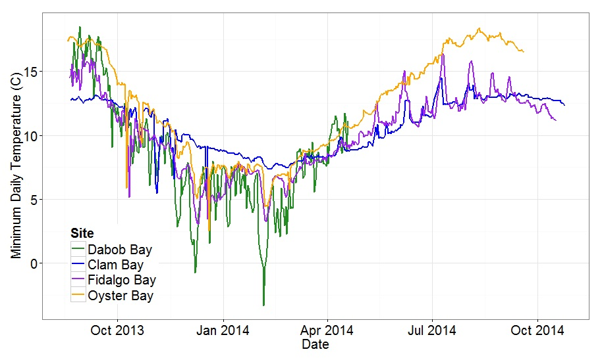
Reciprocal Transplant - Results: Temperatures

Slide 58
Stock Structure - Growth

Slide 59
Stock Structure - Reproduction

